Slide 1

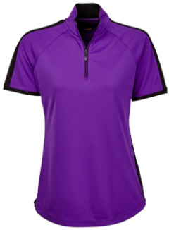



Women’s Rose
Cottage Charity Day
Thursday 30th May 2019
Supporting Northern Women’s Health Centre
Wear Purple to Support “Rose Cottage”
4 person Team Stableford
1 on Par 3, 2 on Par 4 & 3 Par 5
Straight Drives, NTP’s
Entry Fee $30 includes Sausage Sizzle
8:30AM SHOTGUN START
Morning Tea From 7AM
Limited Field – First in best dressed
ENTRIES CLOSE
16th May 2019
Forward Entry Forms to –
The Secretary Wyong Women’s Golf
319 Pacific Highway
WYONG NSW 2259

Slide 2
Women’s Rose
Cottage Charity Day
Thursday 30th May 2019
Conditions of Play
The rules of Golf and the local rules of Wyong Women’s Golf shall be the rules of play. Program may be altered by the match committee. Golf NSW countback system will apply. No money to be refunded after the closing date. Late entries may be taken. Motorised transport permitted. Buggies must have wide wheels. In the event of a dispute, match committee’s decision is final.
PAYMENT METHOD – DIRECT DEPOSIT
BANK: Bendigo Community Bank
ACC Name: Wyong Ladies Golf
BSB: 633-000
ACCOUNT: 163 732 480
REF: Name of first player on the Entry Sheet
ENTRIES CLOSE
16th May 2019
Forward Entry Forms to –
The Secretary Wyong Women’s Golf
Via Post: 319 Pacific Highway
WYONG NSW 2259 OR
Via Email: Ladiesgolf@wyonggolfclub.com.au
$30.00 Per Player

